Slide 1
RP-US-C Sensor Application for Autonomous Illumination Control Master Thesis under the guidance of Dr. Prof. Peter Nauth and Dr. Prof. Andreas Pech Aamir Muhammad 1272918

Slide 2
Introduction
Objectives
Used Hardware
Ultrasonic Sensing
Used Software
Fast Fourier Transform
Development and Statistical Analysis of features
I2C Protocol and Threading
Automate the Program using Cronjob

Slide 3
Objectives
Learning about design of the Ultrasonic sensor SRF02 and how to use it.
Development and installation of a sensor system for switching desk illumination
Switch functions with help of Relays and multithreading
Sensor must start measurement on power up by itself. Automate Red pitaya
Validation of sensor system by comparing sensor actions with presence of human e.g. by using a camera
Notes:
There are numerous research going on in the path to object recognition or detection using approaches of machine learning together with a different type of sources as input data, such as images and videos. This thesis work is little different than data training and machine learning approach but is a small contribution to the same. We will be calculating the Fast Fourier Transform of the reflected received signal and extract different features from it on run time.

Slide 4
Used Hardware
2 LED PWR121 Lights
2 Relay module HF3FA gravity version 4.0
Red Pitaya
Ultrasonic Sensor SRF02
Webcam
Notes:
In the upcoming slides we will discuss these one by one.

Slide 5
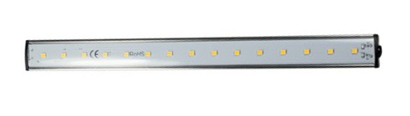
LED PWR121
This is a chargeable light. Normally this LED comes with an ON/OFF button to the side which when pressed for 2 seconds will turn ON the light. Just pressing the button will decreases the luminance and pressing it again for 2 seconds will turn OFF PWR121. But in our case will not manually press the button rather this functionality will be controlled by the RELAY module to switch the light ON and OFF.
Notes:
Two LED PWR121 lights has been used in this project. One is white light which will indicate the presence of Human or soft object. The second one is blue in color which will signify the presence of hard object or no object.

Slide 6
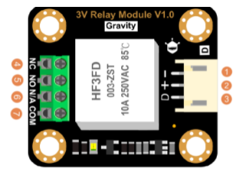
HF3FA Relay
2 Relays are used. One for the white light and one for the blue light. To switch white light ON and OFF the relay is connected to the DIO2_P of the Red Pitaya and similarly for the blue light Relay is connected to the DIO3_P of the Red Pitaya.
When we make the DIO pins high for 2 sec the relay will operate and turn the light on.
Notes:
These relays are compatible with Red Pitaya, Arduino boards and also other boards like Intel. It can work with 3.3V devices. It is designed specifically for low-voltage devices. Up to 10A current can be handled plus an LED on the board indicates the state of the relay. 1 NO and 1 NC terminal is included. A 3-pin interface is provided to make it plug and play.

Slide 7
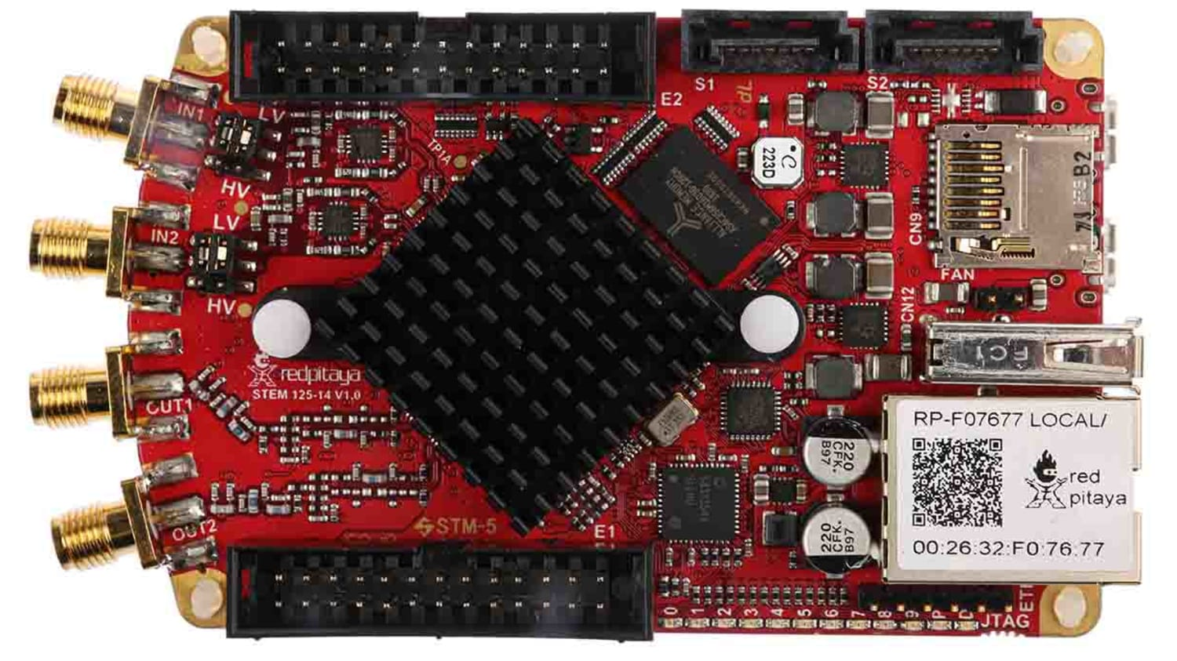
Red Pitaya
Red Pitaya is an electronic instrument intended to be alternative for many expensive laboratory measurement and control instruments. It is known as open-source, though the hardware design is proprietary.
Notes:
It has two RF input and two RF outputs, it has 14 bit analog-to-digital (ADC) and digital-to-analog converters. The software includes oscilloscope, spectrum analyzer, signal generator, LCR meter , and 50 MHz 2x2 MIMO PID controller. It can be re-programmed, There are also auxiliary ADC and digital IO.
It has USB port, Wi-Fi, Ethernet connector. Internally, it uses Linux as operating system. The mass storage device for the operating system is a micro-SD card. We used an ultrasonic sensor SRF02 which is connected to the Red Pitaya in I2C mode. We will discuss about I2C in coming slides

Slide 8
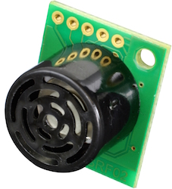
SRF02 Ultrasonic Sensor
The SRF02 is an ultrasonic rangefinder with a single transducer on a tiny PCB.
It can be used as serial or I2C mode of communication.
Minimum measuring range is roughly 30 cm.
Notes:
We used it in I2C mode of communication. In which case the mode pin must be disconnected. Only 2 pins will be used SDA and SDL. SDA is for the serial DATA and SDL is for serial Clock.

Slide 9
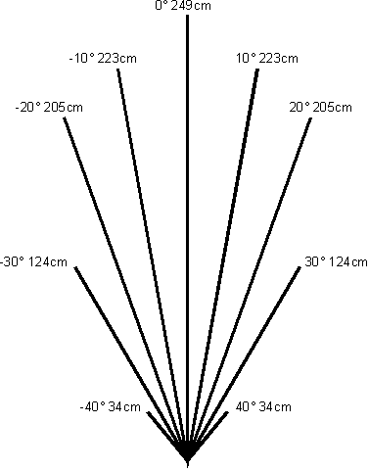
Beam Pattern of SRF02
Notes:
Here is the beam pattern of Ultrasonic Range finder. As we can see that directly in front of sensor it can detect objects with in a range of 2.5 meter but to the sides of it the Range of detection decreases.

Slide 10
Ultrasonic Sensor
Ultrasonic sensors use sound waves above the 20 kHz range to detect objects in proximity, similar to how bats use echolocation to maneuver without colliding into obstacles .
Principles of Ultrasound
Ultrasonic sensors can measure distance and detect the presence of an object without making physical contact.
Effective Range – between few centimeter up to several meters.
Notes:
In the automotive space, ultrasonic sensors are prevalent, specifically for parking assist where 4–16 sensors are used to detect obstacles when parking a vehicle. In the industrial space, ultrasonic sensors are used in robotics and other applications that require reliable presence, proximity, or position sensing.
The ultrasonic sensor is a piezoelectric transducer, which is able to convert an electrical signal into mechanical vibrations, and mechanical vibrations into an electrical signal. Therefore, in a monostatic approach, the ultrasonic sensor is a transceiver which operates as both a speaker and microphone at a single frequency.

Slide 11
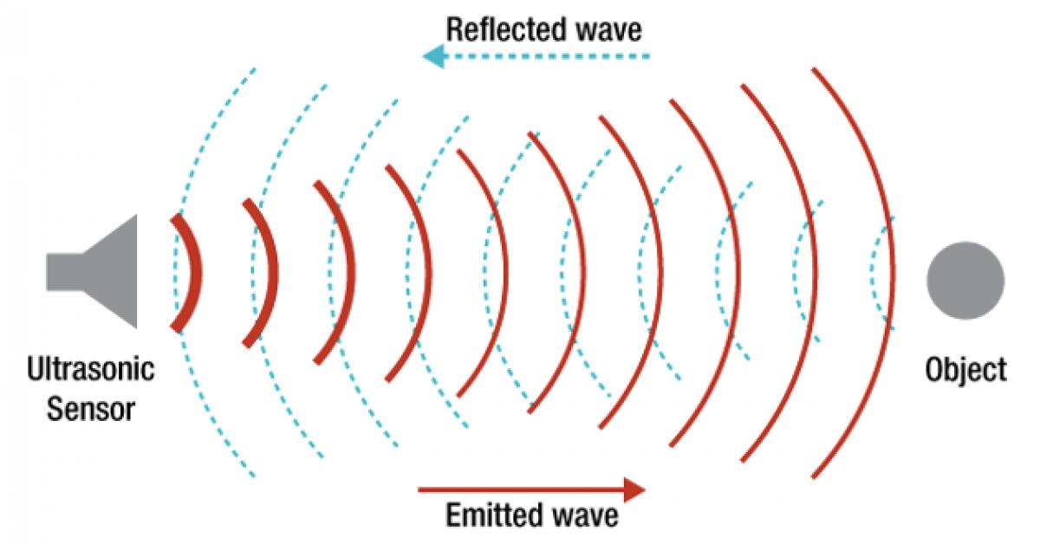
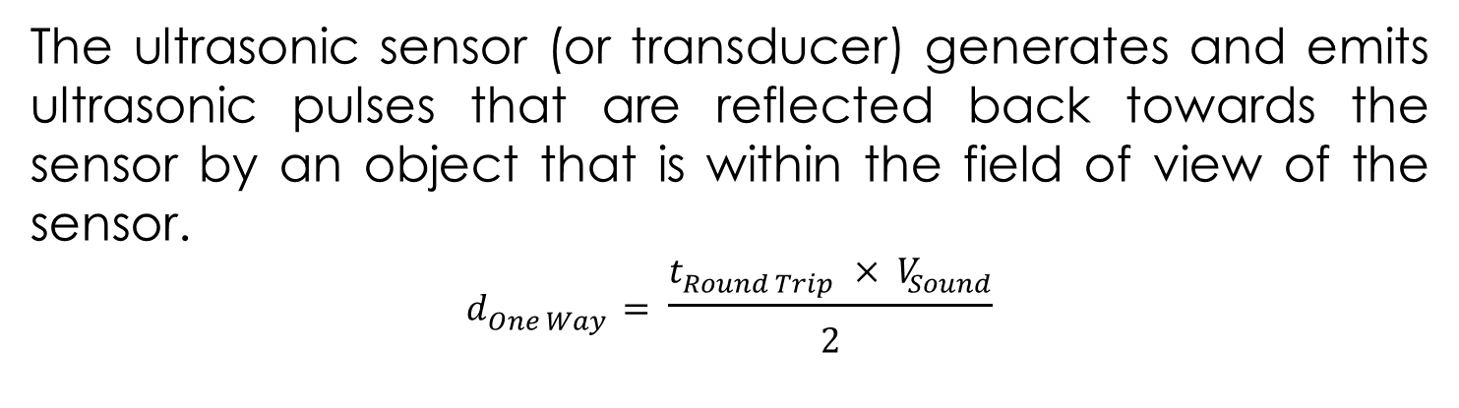
The ultrasonic sensor (or transducer) generates and emits ultrasonic pulses that are reflected back towards the sensor by an object that is within the field of view of the sensor.
$$d_{One Way}= \frac{t_{Round Trip} × V_{Sound}}{2}$$
Notes:
The sensor is able to capture the difference in time between the emitted and received echo. Because the speed of sound is a known variable i.e 343 m/s, the captured round-trip time can be used to calculate the distance between the sensor and object.

Slide 12
Why Use Ultrasonic Sensing?
Can detect variety of materials, regardless of shape, transparency or color
Only requirement the target material is a solid or liquid.
This enable contactless detection of water, glass, wood, Sand and plastic etc.
Optical sensing technologies where light is used instead of sound can be used but it has limitation to smoky and foggy environments.
Also light passes through the transparent materials.
Radar and LIDAR based technologies are more expensive

Slide 13
Typical Ultrasonic-Sensing Applications
Ranging Measurement: Periodically records the distance of one or more objects moving to or from the sensor.
Surface Type Detection: Using ultrasonic data material softness and hardness can be measured. Ultrasonic sound waves bounce off harder surfaces towards the transducer with fewer losses, which provides a stronger echo response in return. Softer objects, like foam and carpet, absorb many of the sound waves and provide a weaker echo response.
Notes:
Curved objects or tilted objects may scatter the majority of ultrasonic waves transmitted towards the object, which provides a weak echo response.

Slide 14
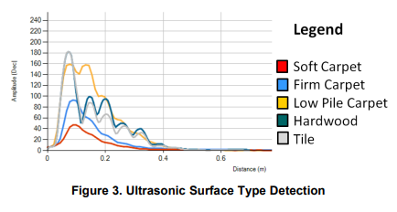
“Ultrasonic Sensing Basics”, Texas Instruments, 2019
Notes:
These results are taken from a report of Texas Instrument. The title of the report is “Ultrasonic Sensing Basics”. As we can see objects like soft carpet has weak echo response with a low amplitude and hard objects like tile has a strong echo response.

Slide 15
Used Software
MS Visual Studio 2019
UDP Client
Putty
WinSCP
Microsoft Excel
Notes:
Visual Studio : It is used to create a C project code with all necessary software bundles needed for communication to / with RP.
UDP Client : It is developed by Mr. Daniel Schafer in C# and C. Which is using 3 Thread mainly. The Time Thread, Server Thread and measure Thread. Than I created a 4th thread called Led Thread. Which will control. The ON OFF functionality of the lights connected to the Red Pitaya.
Putty : It is used to establishing SSH connection, to make or build the code and for debugging purposes.
WinSCP : It works on windows platform. It uses the “secure copy protocol” to provide a remote view of the files in RedPitaya.
Microsoft Excel : it is used to take a graphical look of the different features of soft and hard object. And select a proper threshold for classification.

Slide 16
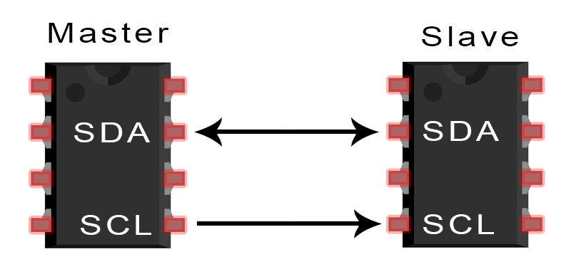
I2C Protocol
I2C “Inter-Integrated Circuit” protocol which basically combing some of the properties of SPI and UART communication protocol.
Notes:
only 2 wires are in used i.e., SDA and SCL to exchange data between devices. Data has been transferred from one end to other end by a bit-by-bit fashion making use of a single wire (the SDA line). SCL line is used for clock signals. In our case we have master Red Pitaya and slave is the ultrasonic sensor.

Slide 17
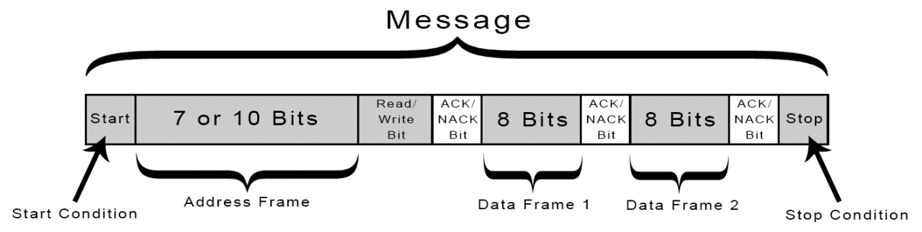
Header of I2C Message
Start condition
Stop condition
Address Frame
Data Frame
Read/Write bit
ACK/NACK bit
Notes:
Start Condition: The master transmits the start condition to each, and every slave connected by changing the SCL line from a high voltage level to a low voltage level after switching the SDA line from high to low.
Stop Condition: by changing SCL high before changing SDA a stop condition is send to the slave which will ultimately stops the transmission.
Address Frame: Each slave is identified by an Address Frame. This Address frame is normally 7-10 bit long and is unique for each slave. Whenever master wants to communicate to a particular slave its address is used in the Address Frame.
Read/Write Bit: This is a single bit which is indicating if the master is waiting for the data to be received from the slave side or wants to send the data to the slave. If this bit is low voltage that is 0 the master is sending if it is high voltage that is 1 master is requesting data from the slave.
ACK/NACK Bit: This bit is notifying about the status of the last data frame. Each data frame is followed by ACK/NACK bit. The receiving end will send an ACK bit to the sender if the data frame is received successfully if it did not deliver properly a NACK bit is sent [8].

Slide 18
I2C Linux Kernel
Linux/i2c-dev.h is a header file that is used in this project
Starting from 0 each and every sensor or any other peripheral device is assigned with a number. This can be checked in the path /sys/class/i2c-dev/ to see which registered sensor has what number.
as per the project demand we have 1 master and 1 slave so the communication will be purely between them.
After connecting to the Red Pitaya through ssh and using the "i2cdetect -l“ command to obtain a list of all i2c devices registered at the moment on the Red Pitaya.

Slide 19
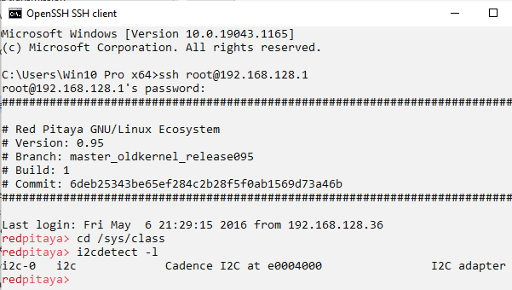
Each device has a number. Here we have i2c-0. if we have more devices it will take the number in the format like "i2c-%d" (i2c-0, i2c-1, ..., i2c-10, ...).

Slide 20
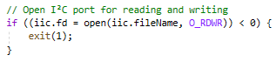
Opening of the Bus
To interact with the I2C peripheral devices in simple way the first and important thing to start this communication is to open the bus for writing and reading.

Slide 21
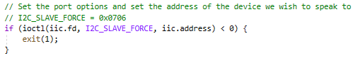
Starting communication
When the device has been opened, its specification is necessary for further operations. We can set the address of the slave device to which we would like to communicate. Here the master wants to communicate to I2C slave of the address 0x0706.
Notes:
We must start the communication with ultrasonic sensor which is a slave here in this case after the bus is successfully acquired. As from the previous discussion we know that I2C will do this by sending a message which contain 7-bit address of the slave followed by a read/write bit.

Slide 22
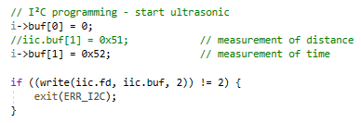
Writing to ADC
To obtain data from Ultrasonic Sensor the write system call is initiated. Write demands a buffer in which the data will be stored, a file handle, and the number of bytes to write must be mentioned. Write will try to write the number of bytes given and will return the total number of bytes written, making use of that we can check for errors

Slide 23
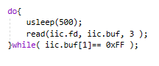
Reading from ADC
The read segment of code is used to obtain data from the I²C peripheral. Read demands a buffer to store the data, a file handle, and a number of bytes to read. Read will try to read the number of bytes stated and will return the total number of bytes for reading.

Slide 24
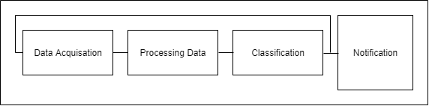
System Overview
Red Pitaya with Ultrasonic Sensor is used for data acquisition to sample the data.
FFT and a number of feature are calculated
A box_Classifier is implemented to differentiate between hard and soft objects
For the notification white and Blue LED are employed which switch ON and OFF with the help of Relays

Slide 25
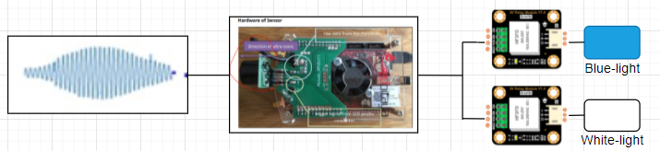
Block Diagram
Ultrasonic Signal
Red Pitaya with ultrasonic Sensor
2 HF3FA Gravity Relays
2 PWR121 led lights. Blue light and white light
Blue light – objects other than human (hard objects)
White light – for human (soft object)
Notes:
the overall architecture of the system is mainly consisting of 4 components, that are ultrasonic signals which are reflected from an object as input data, an instrument called Red Pitaya with an ultrasonic sensor, will change the sound waves or mechanical vibrations to electrical signal, and will be handling the ADC, FFT. After the FFT 10 different features are extracted. Two of the feature are used for classification, 2 Gravity HF3FA relays each connected with an LED. The blue LED for hard objects i.e., objects other than humans and white LED for soft objects i.e., humans.

Slide 26
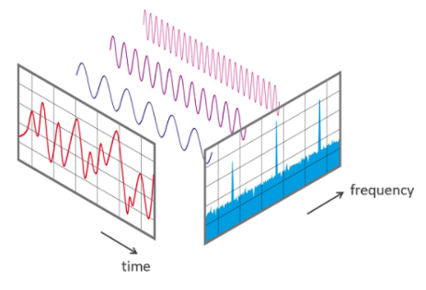
Fast Fourier Transform
Notes:
The "Fast Fourier Transform" (FFT) is an important measurement method in the science of audio and acoustics measurement. It converts a signal into individual spectral components and thereby provides frequency information about the signal. So in time domain we have a complex signal which we can split into a number of sinusoid of different frequencies and amplitude. Than in frequency domain we can see each and every signal of different frequencies with respect to its amplitude.

Slide 27
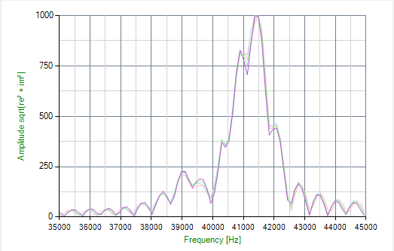
FFT of Human
Notes:
Here we have a graph of the FFT of human.

Slide 28
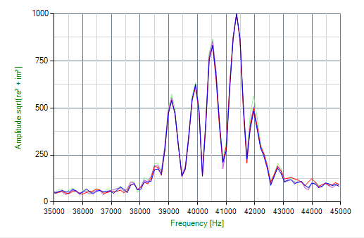
FFT of Empty Seat
Notes:
As we can see that FFT graph of the 2 classes i.e Human and No Human is quiet different. The Human graph is smooth while for hard object the graph has many sharp edges. So we will extract different features from it and on the basis of it we will do classification.

Slide 29
Extracted Features
A total of 10 feature are calculated from the FFT. but classification is done on basis of 2 features i.e F1 and F4.
F1: Mean difference between frequencies of neighbored measurements of center frequency (max. peak), i.e. moving average over 10 frequency differences of neighbored center frequency (diff_sum)
F2: Center frequency (max. peak)
F3: Mean of F2 over 10 measurements
F4: Variance of F2 over 10 measurements

Slide 30
Features Extraction (cont)
F5: Number of peaks (within frequency range around 39.5 – 40.5 kHz ±500 Hz of F2)
F6: Mean of F5 over 10 measurements
F7: Variance of F5 over 10 measurements
F8: Mean frequency distance of 3 peaks (left of center frequency, center frequency, right of center frequency (max. peak)
F9: Mean of F8 over 10 measurements
F10: Variance of F8 over 10 measurements

Slide 31
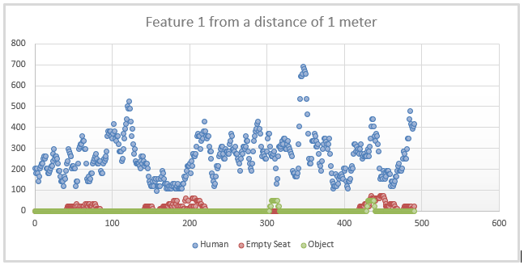
Notes:
F1 is the Mean difference between frequencies of neighbored measurements of center frequency (max. peak), i.e. moving average over 10 frequency differences of neighbored center frequency (diff_sum) which we are getting from the FFT. As we can see from the analysis of Feature 1. The value obtained for Human are greater than 100. And for hard object the value are zero or less than a value of 100. So we can set a threshold of 100 here for classification.

Slide 32
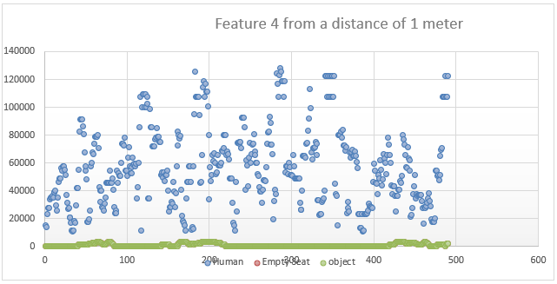
Notes:
F4 is the Variance of F2 over 10 measurements. F2 here is the center frequency (max peak) which we are getting from the FFT. As we can see from the analysis of Feature 4. The value obtained for Human are greater than 10000. And for hard object the value are zero or 2 to 3 digits range. So we can set a threshold of 10000 here for classification.

Slide 33
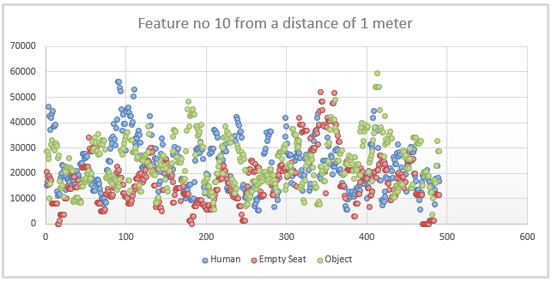
Notes:
Some of the features I checked has value where we don’t have clear line between different classes of object. So those we cannot use for classification. As we can see in case of feature no 10. where F10 is the variance of the values of the mean frequency distance of 3 peaks (left of center frequency, center frequency, right of center frequency)

Slide 34
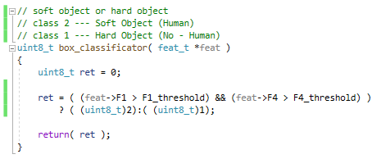
Box_Classifier
2 features are used i.e. F1 and F4 based on the statistical analysis with a threshold. If it exceeds the threshold the class identified will be 2 otherwise will be 1.

Slide 35
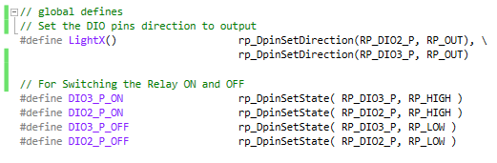
Variable Initialization for DIO pins
Notes:
Here is a part of the code. We initialize the DIO pins as output and define the HIGH and LOW states for the Switching ON and OFF of the relays

Slide 36
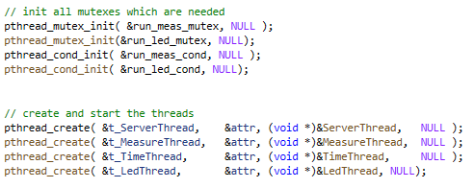
Creating Threads
Notes:
On RP the software runs as a daemon in background. Four threads are used to let the binary code run on the system. With the first thread that is the TimeThread main is started and three new threads are created.
The second thread is listening on port 61231 by a UDP server. The thread is in blocked mode until a message comes in via UPD. The message is parsed and gives a signal to the third thread to run.
The third thread which is Measure Thread is waiting for a signal from the server thread, which is able to deliver a command and a value. For example, “-a 1” means: “start ADC output”.
The fourth thread will start inside the third thread every time human, or no human is detected by the sensor. This thread is in blocked mode until a message comes in and start the White or Blue LED depending on the class of the Object. Inside the LedThread the current state of the LEDs is maintained. So, every time the thread is called from the MeasureThread the LedThread is able to keep track of the last status of the LEDs.

Slide 37
Measurement
thread
Box Classifier
Object Class (1 or 2)
Led Thread
Switch the Light ON and OFF according to the class
Notes:
In the measurement Thread we start ADC, calculate the FFT and extract features. Than we have box Classifier which will return object class either 1 or 2. The object class will trigger the Led Thread. In the Led Thread we will Switch the 2 light ON and OFF depending on the class received.

Slide 38
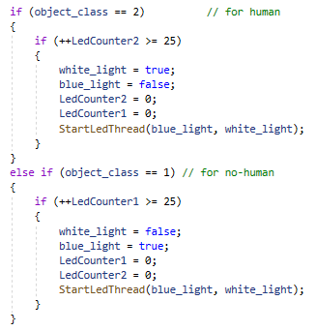
Starting the LED thread
Notes:
In This code as we can see every time we got value from the box_classifier about the class that is either 1 or 2. An LedThread will start. So if we have Object_class 2 which is for human Ledthread will start with a white light value of true and blue light value of false. Which when used in the thread will switch ON the white light and turns OFF the blue light. Similarly if object class 1 is encounter the ledThread will start with white light value of false and blue light value of true.

Slide 39
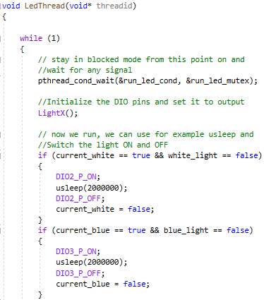
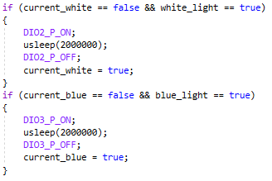
Switching the Lights
Notes:
Here in the ledThread depending on the values we received from Measurement thread class. We will check for the current status of Lights and switch ON and OFF the lights if required. For example if white light is already ON and we receive an Object class of 2 so nothing will happens as white light indicates a human. But if White light is ON and Object class 1 encounters so white Light will turn OFF and Blue will turn ON.

Slide 40
Automate Red Pitaya and Starting Sensor
cron
It is a utility which is mainly doing repetitive or scheduler task on Linux or Unix like operating systems.
crontab
Is a file which contains commands and intervals.
cronjob
And the job which we will be doing by making use of command is known as cronjob
Notes:
Cron is a tool used by users who set up and maintain software systems to plan shell scripts or commands to run at specific intervals or times. Although its general nature makes it handy for tasks like files downloading from the Servers and providing email at regular intervals when received, it is often used to automate system care or administration. I used it here for starting the ultrasonic sensor automatically when it is powered ON.

Slide 41
Requirements
Linux or Unix Operating System(Red Pitaya GNU/Linux Ecosystem version 0.95)
Administrator rights as a user or sudo privileges.
Terminal window/ Putty
Existing Cron Jobs
Connect to the red pitaya using ssh root@192.168.128.1
To check all the cron jobs running on a system we can simply use the command crontab –l
@reboot sh /root/start-sensor.sh &. This command describes that at the reboot of RedPitaya a shell script file will run

Slide 42
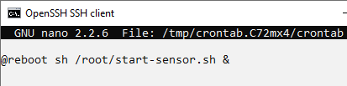
Crontab File Editing
To check the configuration files of cron tables in Red Pitaya we can enter the following segment of command in CMD terminal window. In this way we can open the cron tables.
crontab –e
Start-sensor.sh is shell scripting file where the series of commands are used to instruct the starting of sensor

Slide 43
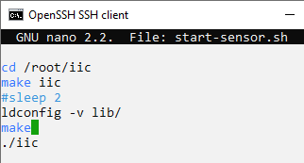
Start-sensor.sh
Change the directory
Build the iic file
Check the header and file names of libraries it meets when establishing which versions should have their link renewed
Build the whole program
Command to start the sensor.

Slide 44
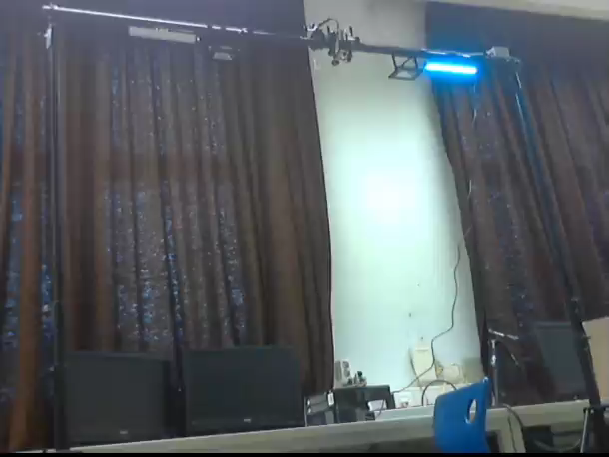
Validation

Slide 45
Thank you

